Slide 1
TRW LAb
TOPIC – SOLAR AUTOMOBILE

Slide 2
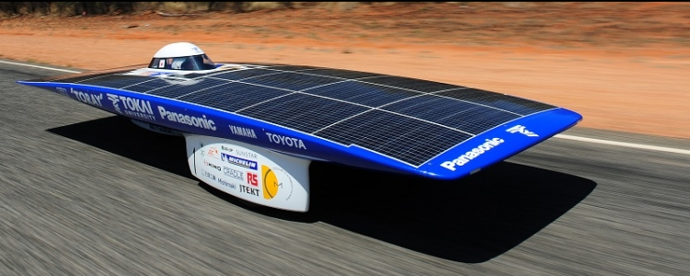

Slide 3
Submitted by:
Siddharth Singh
CSE 2B

Slide 4
INTRODUCTION
A solar vehicle is an electric vehicle powered completely or significantly by direct solar energy. Usually, photovoltaic (PV) cells contained in solar panels convert the sun's energy directly into electric energy. The term "solar vehicle" usually implies that solar energy is used to power all or part of a vehicle's propulsion. Solar power may be also used to provide power for communications or controls or other auxiliary functions.
Solar vehicles are not sold as practical day-to-day transportation devices at present, but are primarily demonstration vehicles and engineering exercises, often sponsored by government agencies. However, indirectly solar-charged vehicles are widespread and solar boats are available commercially.

Slide 5
WHAT IS SOLAR ENERGY ?
Solar energy is radiant light and heat from the Sun that is harnessed using a range of ever-evolving technologies such as solar heating, photovoltaics, solar thermal energy, solar architecture, molten salt power plants and artificial photosynthesis.
It is an important source of renewable energy and its technologies are broadly characterized as either passive solar or active solar depending on how they capture and distribute solar energy or convert it into solar power. Active solar techniques include the use of photovoltaic systems, concentrated solar power and solar water heating to harness the energy. Passive solar techniques include orienting a building to the Sun, selecting materials with favorable thermal mass or light-dispersing properties, and designing spaces that naturally circulate air.

Slide 6
LAND
SOLAR CARS
Solar cars depend on PV cells to convert sunlight into electricity to drive electric motors. Unlike solar thermal energy which converts solar energy to heat, PV cells directly convert sunlight into electricity.
The design of a solar car is severely limited by the amount of energy input into the car. Solar cars are built for solar car races and also for public use List of prototype solar-powered cars. Even the best solar cells can only collect limited power and energy over the area of a car's surface. This limits solar cars to ultralight composite bodies to save weight. Solar cars lack the safety and convenience features of conventional vehicles. The first solar family car was built in 2013 by students in the Netherlands. This vehicle is capable of 550 miles on one charge during sunlight. It weighs 850 pounds and has a 1.5kw solar array.

Slide 7
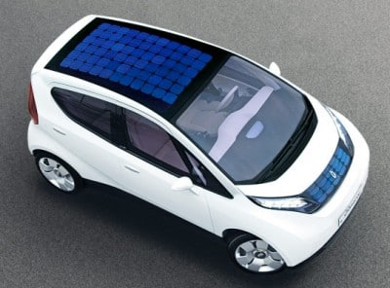

Slide 8
SOLAR BUSES
Solar buses are propulsed by solar energy, all or part of which is collected from stationary solar panel installations. The Tindo bus is a 100% solar bus that operates as free public transport service in Adelaide City as an initiative of the City Council. Bus services which use electric buses that are partially powered by solar panels installed on the bus roof, intended to reduce energy consumption and to prolong the life cycle of the rechargable battery of the electric bus, have been put in place in China.

Slide 9
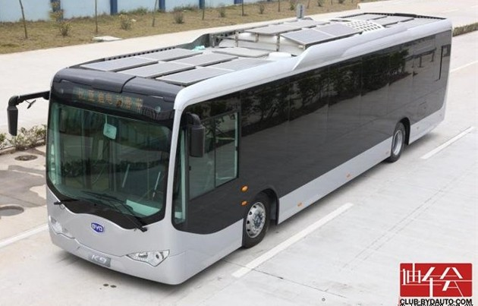

Slide 10
SINGLE-TRACK VEHICLES
The first solar "cars" were actually tricycles or Quadracycles built with bicycle technology. These were called solarmobiles at the first solar race, the Tour de Sol in Switzerland in 1985. With 72 participants, half used solar power exclusively while the other half used solar-human-powered hybrids. A few true solar bicycles were built, either with a large solar roof, a small rear panel, or a trailer with a solar panel. Later more practical solar bicycles were built with foldable panels to be set up only during parking. Even later the panels were left at home, feeding into the electric mains, and the bicycles charged from the mains.

Slide 11
AUXILIARY POWER
Photovoltaic modules are used commercially as auxiliary power units on passenger cars in order to ventilate the car, reducing the temperature of the passenger compartment while it is parked in the sun. Vehicles such as the 2010 Prius, Aptera 2, Audi A8, and Mazda 929have had solar sunroof options for ventilation purposes.
The area of photovoltaic modules required to power a car with conventional design is too large to be carried on board. A prototype car and trailer has been built Solar Taxi. According to the website, it is capable of 100 km/day using 6m² of standard crystalline silicon cells. Electricity is stored using a nickel/salt battery. A stationary system such as a rooftop solar panel, however, can be used to charge conventional electric vehicles.

Slide 12
It is also possible to use solar panels to extend the range of a hybrid or electric car, as incorporated in the Fisker Karma, available as an option on the Chevy Volt, on the hood and roof of "Destiny 2000" modifications of Pontiac Fieros, Italdesign Quaranta, Free Drive EV Solar Bug, and numerous other electric vehicles, both concept and production. In May 2007 a partnership of Canadian companies led by Hymotion added PV cells to a Toyota Prius to extend the range. SEV claims 20 miles per day from their combined 215W module mounted on the car roof and an additional 3kWh battery

Slide 13
It is also technically possible to use photovoltaic technology,(specifically thermophotovoltaic (TPV) technology) to provide motive power for a car. Fuel is used to heat an emitter. The infrared radiation generated is converted to electricity by a low band gap PV cell (e.g. GaSb). A prototype TPV hybrid car was even built. The "Viking 29" was the World’s first thermophotovoltaic (TPV) powered automobile, designed and built by the Vehicle Research Institute (VRI) at Western Washington University. Efficiency would need to be increased and cost decreased to make TPV competitive with fuel cells or internal combustion engines.

Slide 14
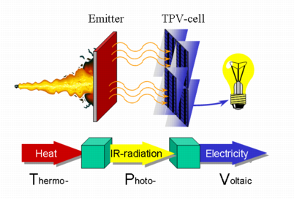

Slide 15
RAIL
Railway presents a low rolling resistance option that would be beneficial of planned journeys and stops. PV panels were tested as APUs on Italian rolling stock under EU project. PVTRAIN. Direct feed to a DC grids avoids losses through DC to AC conversion. DC grids are only to be found in electric powered transport: railways, trams and trolleybuses. Conversion of DC from PV panels to grid alternating current (AC) was estimated to cause around 3% of the electricity being wasted.

Slide 16
PVTrain concluded that the most interest for PV in rail transport was on freight cars where on board electrical power would allow new functionality:
GPS or other positioning devices, so as to improve its use in fleet management and efficiency.
Electric locks, a video monitor and remote control system for cars with sliding doors, so as to reduce the risk of robbery for valuable goods.
ABS brakes, which would raise the maximum velocity of freight cars to 160 km/h, improving productivity.

Slide 17
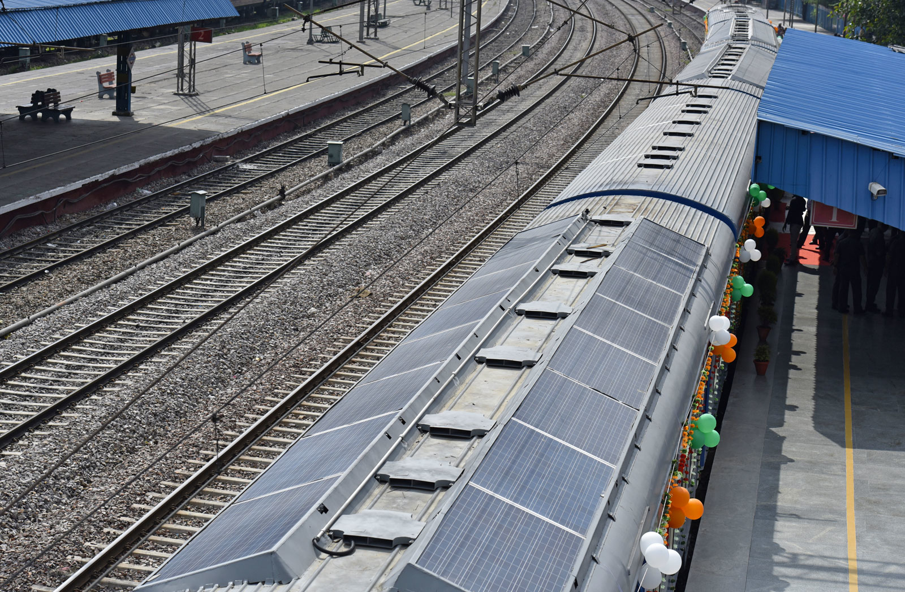

Slide 18
WATER
Planet Solar, the world's largest solar-powered boat and the first ever solar electric vehicle to circumnavigate the globe (in 2012).
Solar powered boats have mainly been limited to rivers and canals, but in 2007 an experimental 14m catamaran, the Sun21 sailed the Atlantic from Seville to Miami, and from there to New York. It was the first crossing of the Atlantic powered only by solar.
Japan's biggest shipping line Nippon Yusen KK and Nippon Oil Corporation said solar panels capable of generating 40 kilowatts of electricity would be placed on top of a 60,213 ton car carrier ship to be used by Toyota Motor Corporation.

Slide 19
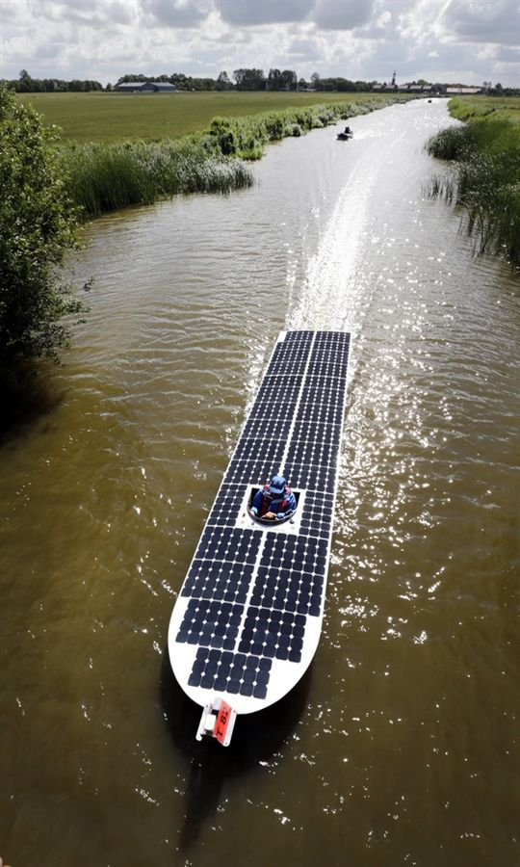

Slide 20
AIR
Solar ships can refer to solar powered airships or hybrid airships.There is considerable military interest in unmanned aerial vehicles (UAVs); solar power would enable these to stay aloft for months, becoming a much cheaper means of doing some tasks done today by satellites. In September 2007, the first successful flight for 48h under constant power of a UAV was reported. This is likely to be the first commercial use for photovoltaics in flight.
Many demonstration solar aircraft have been built, some of the best known by AeroVironment.

Slide 21
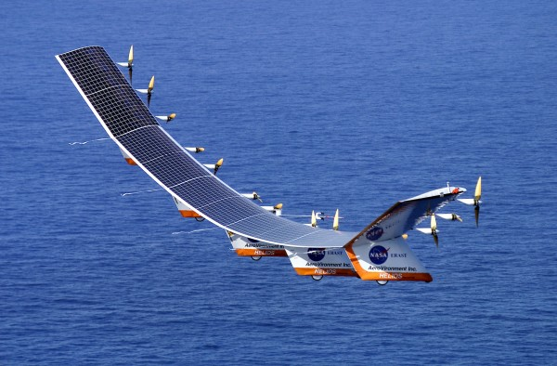

Slide 22
MANNED SOLAR AIRCRAFT
Gossamer Penguin
Solar Challenger - This aircraft flew 163 miles (262 km) from Paris, France to England on solar power.
Sunseeker.
SolarStratos – Swiss stratospheric 2-seater solar plane aims to climb into space.

Slide 23
Solar Impulse – two single-seat aircraft, the second of which circumnavigated the Earth. The first aircraft completed a 26-hour test flight in Switzerland on 8-9 July 2010. The aircraft was flown to a height of nearly 28,000 feet (8,500 meters) by Andre Borschberg. It flew overnight using battery power. The second aircraft, slightly larger and more powerful, took off from Abu Dhabi in 2015, flew towards India and then eastward across Asia. However, after experiencing battery overheating, it was forced to halt in Hawaii over the winter. In April 2016, it resumed its journey, and completed its circumnavigation of the globe, returning to Abu Dhabi on 26 July 2016.

Slide 24
In 2010, the Tûranor PlanetSolar, a 30 metre long, 15.2 metre wide catamaran yacht powered by 470 square metres of solar panels, was unveiled. It is, so far, the largest solar-powered boat ever built. In 2012, PlanetSolar became the first ever solar electric vehicle to circumnavigate the globe.
Various demonstration systems have been made. Curiously, none yet takes advantage of the huge power gain that water cooling would bring.
The low power density of current solar panels limits the use of solar propelled vessels, however boats that use sails (which do not generate electricity unlike combustion engines) rely on battery power for electrical appliances (such as refrigeration, lighting and communications). Here solar panels have become popular for recharging batteries as they do not create noise, require fuel and often can be seamlessly added to existing deck space.

Slide 25
UNMANNED AERIAL VEHICLES
Pathfinder and Pathfinder-Plus - This UAV demonstrated that an airplane could stay aloft for an extended period of time fueled purely by solar power.
Helios - Derived from the Pathfinder-Plus, this solar cell and fuel cell powered UAV set a world record for flight at 96,863 feet (29,524 m).
Zephyr - built by Qinetiq, this UAV set the unofficial world record for longest duration unmanned flight at over 82 hours on 31 July 2008. Just 15 days after the Solar Impulse flight mentioned above, on 23 July 2010 the Zephyr, a lightweight unmanned aerial vehicle engineered by the United Kingdom defence firm QinetiQ, claimed the endurance record for an unmanned aerial vehicle. It flew in the skies of Arizona for over two weeks (336 hours). It has also soared to over 70,700 feet (21.5 km).

Slide 26
FUTURE SOLAR POWERED PROJECTS
Sky-Sailor (aimed at Martian flight)
various solar airship projects, such as Lockheed Martin's "High Altitude Airship"

Slide 27
SPACE
SOLAR POWERED SPACECRAFT
Solar energy is often used to supply power for satellites and spacecraft operating in the inner solar system since it can supply energy for a long time without excess fuel mass. A Communications satellite contains multiple radio transmitters which operate continually during its life. It would be uneconomic to operate such a vehicle (which may be on-orbit for years) from primary batteries or fuel cells, and refuelling in orbit is not practical. Solar power is not generally used to adjust the satellite's position, however, and the useful life of a communications satellite will be limited by the on-board station-keeping fuel supply.

Slide 28
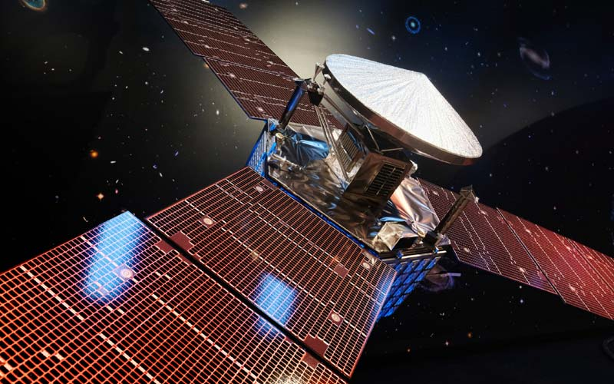

Slide 29
SOLAR PROPELLED SPACECRAFT
A few spacecraft operating within the orbit of Mars have used solar power as an energy source for their propulsion system.
All current solar powered spacecraft use solar panels in conjunction with electric propulsion, typically ion drives as this gives a very high exhaust velocity, and reduces the propellant over that of a rocket by more than a factor of ten. Since propellant is usually the biggest mass on many spacecraft, this reduces launch costs.
Other proposals for solar spacecraft include solar thermal heating of propellant, typically hydrogen or sometimes water is proposed. An electrodynamic tether can be used to change a satellite's orientation or adjust its orbit.
Another concept for solar propulsion in space is the light sail; this doesn't require conversion of light to electrical energy, instead relying directly on the tiny but persistent radiation pressure of light.

Slide 30
PLUG IN HYBRID & SOLAR VEHICLES
An interesting variant of the electric vehicle is the triple hybrid vehicle—the PHEV that has solar panels as well to assist.
The 2010 Toyota Prius model has an option to mount solar panels on the roof. They power a ventilation system while parked to help provide cooling. There are many applications of photovoltaics in transport either for motive power or as auxiliary power units, particularly where fuel, maintenance, emissions or noise requirements preclude internal combustion engines or fuel cells. Due to the limited area available on each vehicle either speed or range or both are limited when used for motive power.

Slide 31
ADVANTAGES
No Emissions : Because solar-powered cars have electric motors, they burn no fuel and produce no emissions.
Preservation Of Natural Resources : Although the panels and other components of a solar-powered car initially consume energy and resources to manufacture, the solar car would require no additional energy input.

Slide 32
No Fuel Cost : There are considerable economic incentives to develop, produce and operate solar cars. Because of their lack of dependence on external fuel sources, they are free from the fuel costs normally associated with gas, diesel, and even hybrid automobiles.
Driving Comfort : Electric motors designed to power solar-cars are generally smaller than the equivalent gas engine, and operate without the noise and vibrations generally associated with conventional cars, according to Elements Online Environment Magazine.

Slide 33
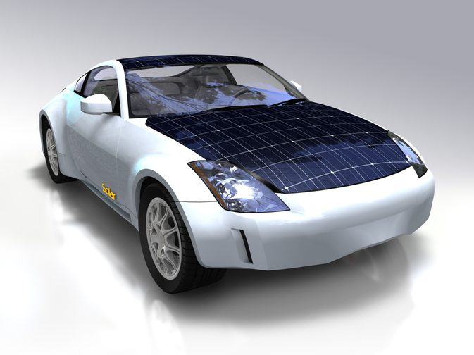

Slide 34
LIMITATIONS
There are limits to using photovoltaic (PV) cells for vehicles:
Power density: Power from a solar array is limited by the size of the vehicle and area that can be exposed to sunlight. This can also be overcome by adding a flatbed and connecting it to the car and this gives more area for panels for powering the car. While energy can be accumulated in batteries to lower peak demand on the array and provide operation in sunless conditions, the battery adds weight and cost to the vehicle. The power limit can be mitigated by use of conventional electric cars supplied by solar (or other) power, recharging from the electrical grid.

Slide 35
Cost: While sunlight is free, the creation of PV cells to capture that sunlight is expensive. Costs for solar panels are steadily declining (22% cost reduction per doubling of production volume).
Design considerations: Even though sunlight has no lifespan, PV cells do. The lifetime of a solar module is approximately 30 years. Standard photovoltaics often come with a warranty of 90% (from nominal power) after 10 years and 80% after 25 years. Mobile applications are unlikely to require lifetimes as long as building integrated PV and solar parks. Current PV panels are mostly designed for stationary installations. However, to be successful in mobile applications, PV panels need to be designed to withstand vibrations. Also, solar panels, especially those incorporating glass, have significant weight. In order for its addition to be of value, a solar panel must provide energy equivalent to or greater than the energy consumed to propel its weight.

Slide 36
CONCLUSION

